Slide 1
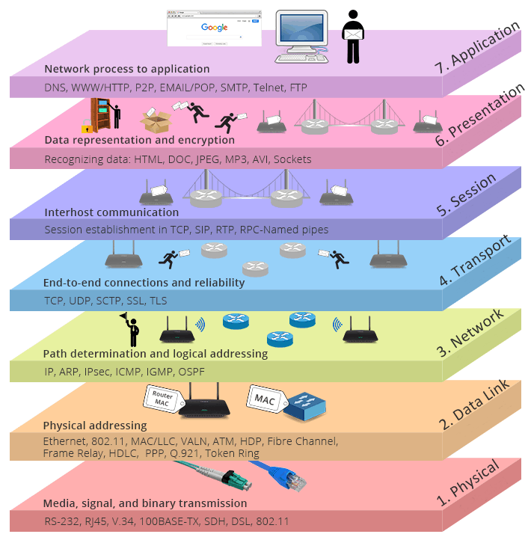
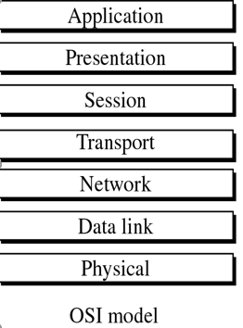
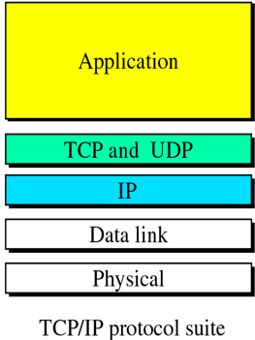
Network Models (OSI and TCP/IP)
Week 6 Part two

Slide 2
Outline
Understanding of the term IP address.
IPv4 (IP version 4) addresses or simply IP addresses using 32 bits.
The need for more addresses, in addition to new generation of IP or IPv6 (lP version 6).
IPv6 uses 128-bit addresses that give much greater flexibility in address allocation.

Slide 3
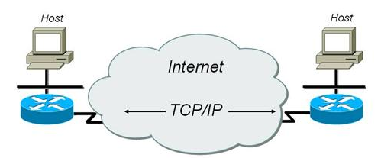
Introduction to TCP/IP
Transmission Control Protocol/ Internet Protocol (TCP/IP) is a set of protocols, or a protocol suite, that defines how all transmissions are exchanged across the Internet.
TCP deals with the ‘end-to-end’ transfer of data between two network nodes. It checks that packets of data have been correctly received and calls for re-transmission if necessary.
IP deals with the routing of data packets through the intermediate networks.

Slide 4
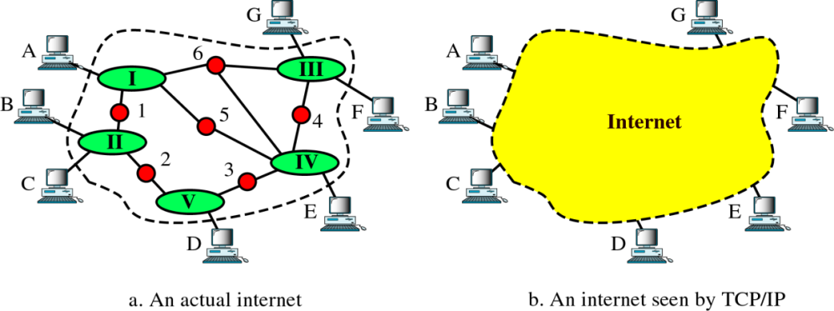
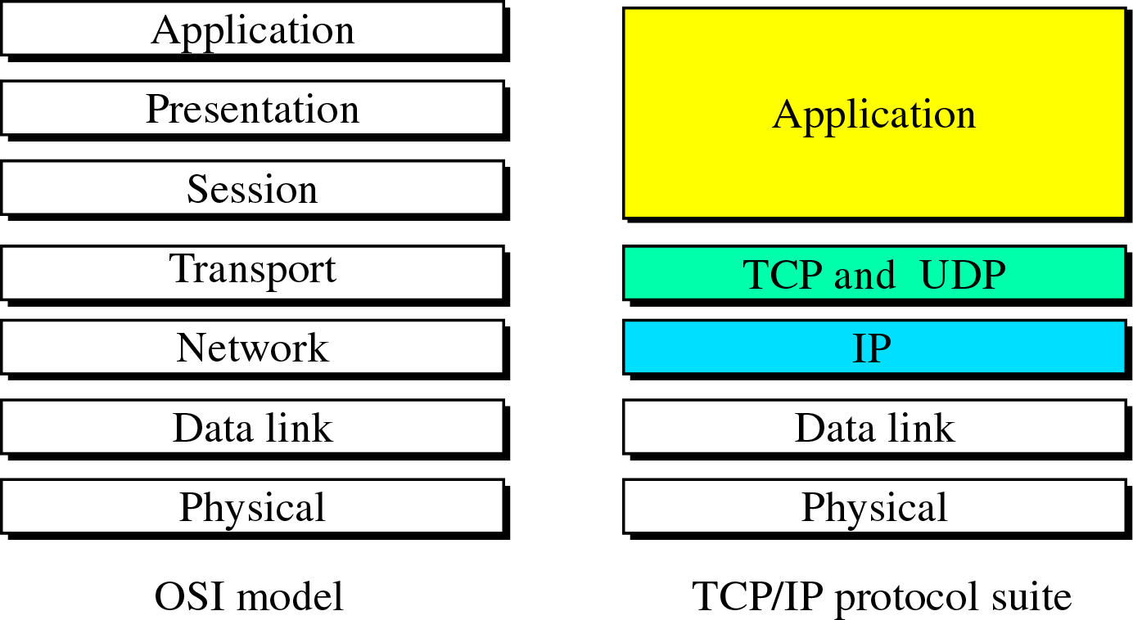
TCP/IP and the Internet
An internet using TCP/IP acts like a single network connecting many computers of any size or type.
Internally, an internet is an interconnection of independent physical networks (such as LANs) linked together by internetworking devices.
The original TCP/IP protocol suite was defined as having four layers: host-to-network, internet, transport, and application.
Internet
Host-to-network

Slide 5
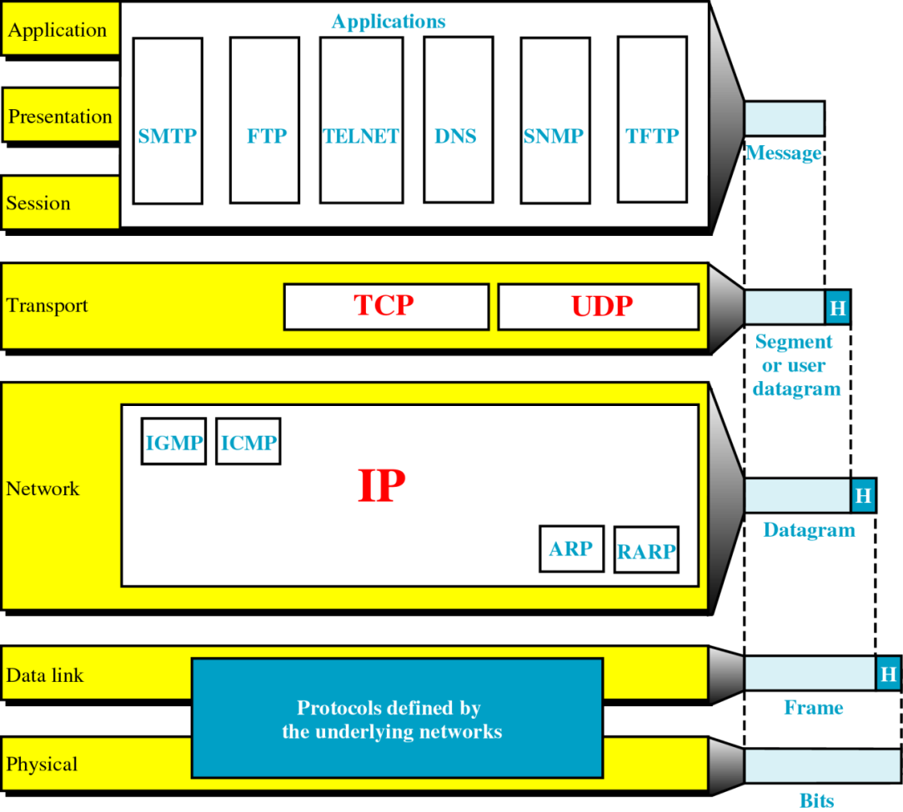
TCP/IP Protocol Suite
The three topmost layers in the OSI model are represented in TCP/IP by a single layer called as the Application Layer.
Transport layer consists of Transmission Control Protocol (TCP), User Datagram Protocol (UDP), and Stream Control Transmission Protocol (SCTP).
At the network layer, the main protocol is Internet Protocol (IP), but there are some other protocols that support data movement in this layer.
At the physical and data link layers, TCP/IP does not define any specific protocol. It supports all the standard and proprietary protocols.
A network in a TCP/IP internetwork can be a local-area network or a wide-area network.
Notes:
SMTP stands for Simple Mail Transfer Protocol. SMTP is used when email is delivered from an email client, such as Outlook Express, to an email server or when email is delivered from one email server to another. SMTP uses port 25.
SCTP (Stream Control Transmission Protocol) is a protocol for transmitting multiple streams of data at the same time between two end points that have established a connection in a network. Sometimes referred to as "next generation TCP" (Transmission Control Protocol) - or TCPng, SCTP is designed to make it easier to support a telephone connection over the Internet (and specifically to support the telephone system's Signaling System 7 - SS7 - on an Internet connection). A telephone connection requires that signaling information (which controls the connection) be sent along with voice and other data at the same time. SCTP also is intended to make it easier to manage connections over a wireless network and to manage the transmission of multimedia data. SCTP is a standard protocol (RFC 2960) developed by the Internet Engineering Task Force (IETF).
Internetwork Packet Exchange (IPX) is the network layer protocol in the IPX/SPX protocol suite. IPX is derived from Xerox Network Systems' IDP. It may act as a transport layer protocol as well.
Domain Name Servers (DNS) are the Internet's equivalent of a phone book. They maintain a directory of domain names and translate them to Internet Protocol (IP) addresses. DNS queries consist of a single UDP request from the client followed by a single UDP reply from the server. The Transmission Control Protocol (TCP) is used when the response data size exceeds 512 bytes, or for tasks such as zone transfers.
The Hypertext Transfer Protocol (HTTP) is an application protocol for distributed, collaborative, hypermedia information systems. HTTP is the foundation of data communication for the World Wide Web. Hypertext is structured text that uses logical links (hyperlinks) between nodes containing text.
Telnet is a protocol that enables you to connect to remote computers and local computers over a TCP/IP network, over TCP port 23. By default, Telnet is disabled in recent Windows environments. To enable Telnet command line utilities: Click Start > Control Panel. Click Programs and Features.
File Transfer Protocol (FTP) is a standard Internet protocol for transmitting files between computers on the Internet over TCP/IP connections.
FTP is a client-server protocol that relies on two communications channels between client and server: a command channel for controlling the conversation and a data channel for transmitting file content. Clients initiate conversations with servers by requesting to download a file. Using FTP, a client can upload, download, delete, rename, move and copy files on a server. A user typically needs to log on to the FTP server, although some servers make some or all of their content available without login, also known as anonymous FTP.
SMTP, POP3 and IMAP are TCP/IP protocols used for mail delivery. If you plan to set up an email server such as hMailServer, you must know what they are used for. Each protocol is just a specific set of communication rules between computers.
Simple Network Management Protocol (SNMP) is a popular protocol for network management. It is used for collecting information from, and configuring, network devices, such as servers, printers, hubs, switches, and routers on an Internet Protocol (IP) network.

Slide 6
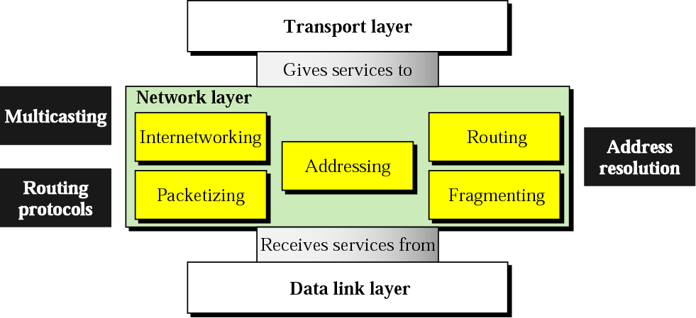
Position of the Network Layer
At the network layer (internetwork layer), TCP/IP supports the Internetworking Protocol.
IP uses four supporting protocols:
Address Resolution Protocol (ARP)
Reverse Address Resolution Protocol (RARP)
Internet Control Message Protocol (ICMP)
Internet Group Management Protocol (IGMP)
Notes:
Address Resolution Protocol (ARP): It is used to associate a logical address with a physical address. It is used to find the physical address of the node when its Internet address is known.
Reverse Address Resolution Protocol (RARP): It allows a host to discover its Internet address when it knows only its physical address. It is used when a computer is connected to a network for the first time or when a diskless computer is booted.
Internet Control Message Protocol (ICMP): It is a mechanism used by the hosts and gateways to send notification of datagram problems back to the sender. ICMP sends query and error reporting messages. For example, Ping ip address.
Internet Group Message Protocol (IGMP): It is used to facilitate the simultaneous transmission of a message to a group of recipients.

Slide 7
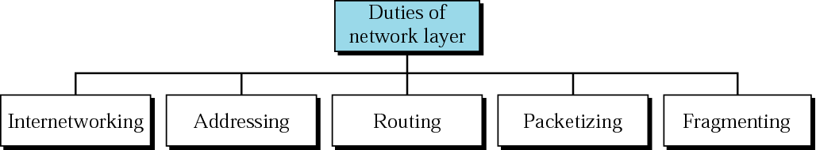
Duties of the Network Layer
The Internetworking Protocol (IP) is the transmission mechanism used by the TCP/IP protocols.
A Network Address is an identifier for a node or network interface of a telecommunications network.
Routing is the process of selecting best paths in a network.
A Packet is the unit of data that is routed between an origin and a destination on the Internet or any other packet-switched network.
Fragmentation means breaking it into smaller pieces,
so that packets may be formed that can pass through a link with a smaller Maximum Transmission
Unit (MTU) than the original datagram size.

Slide 8
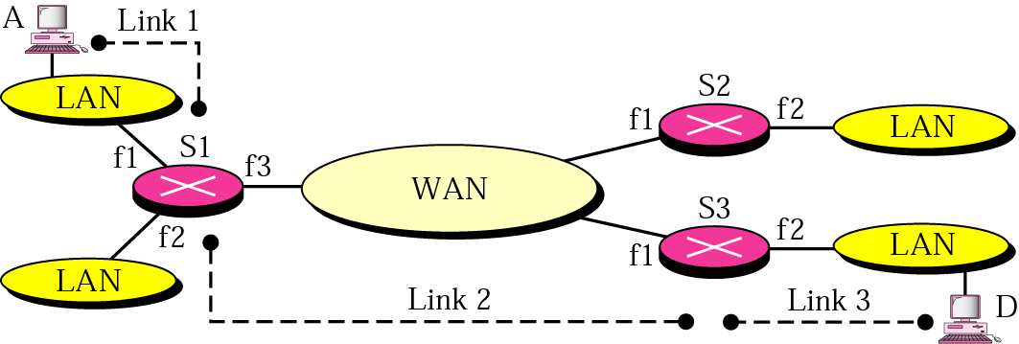
An Internetwork
If the host A needs to send a data packet to host D, the packet needs to go first from A to S1 (a switch or router), then from S1 to S3, and finally from S3 to host D. The data packet passes through three links.
In each link, two physical and two data link layers are involved.
However, there is a big problem here. When data arrive at interface f1 of S1, how does S1 know that interface f3 is the outgoing interface?
Notes:
Switches
A switch does essentially what a hub does, but more efficiently. By paying attention to the traffic that comes across it, it can “learn” where particular addresses are.
Initially, a switch knows nothing and simply sends on incoming messages to all ports: Even accepting that first message, however, the switch has learned something – it knows on which connection the sender of the message is located. Thus, when machine “A” responds to the message, the switches only need to send that message out to the one connection: In addition to sending the response through to the originator, the switch has now learned something else – it now knows on which connection machine “A” is located.
That means that subsequent messages destined for machine “A” need only be sent to that one port: Switches learn the location of the devices that they are connected to almost instantaneously. The net result is that most network traffic only goes where it needs to rather than to every port. On busy networks, this can make the network significantly faster.
Routers
A router is the smartest and most complicated of the bunch. Routers come in all shapes and sizes – from the small, four-port broadband routers that are very popular right now to the large industrial strength devices that drive the internet itself.
A simple way to think of a router is as a computer that can be programmed to understand, possibly manipulate, and route the data that it’s being asked to handle. Many routers today are, in fact, little computers dedicated to the task of routing network traffic.
As far as simple traffic routing is concerned, a router operates exactly as a switch, learning the location of the computers on its connections and routing traffic only to those computers.

Slide 9
An Internetwork
There is no provision in the data link (or physical) layer to help S1 make the right decision and the frame does not carry any routing information either.
The frame contains the MAC or physical address of A as the source and the MAC address of S1 as the destination.
For a LAN or a WAN, delivery means carrying the frame through one link, and not beyond.
The Network Layer is responsible for Host-to-Host delivery and for routing the packets through the routers or switches.

Slide 10
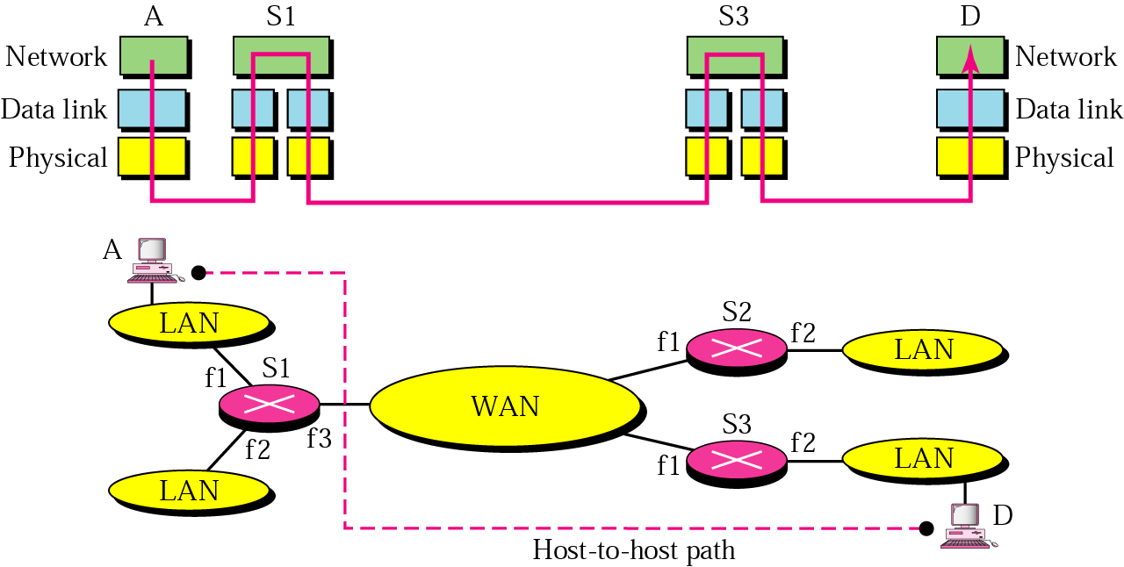
Network Layer in an Internetwork
TCP/IP Internet network model uses
peer-to-peer communication
This figure shows the same internetwork with a network layer added.
The network layer is responsible for the delivery of datagrams between two hosts. This is called host-to-host delivery.

Slide 11
The Internet Layer
IP transports data in packets called datagrams, each of which is transported separately.
Datagrams may travel along different routes and may arrive out of sequence or duplicated.
IP does not keep track of the routes and has no facility for re-ordering datagrams on arrival.
IP provides bare-bones functionality and thereby allows for maximum efficiency.
TCP is used for connection-oriented transmission, whereas connectionless UDP is used for simple message transmissions.

Slide 12
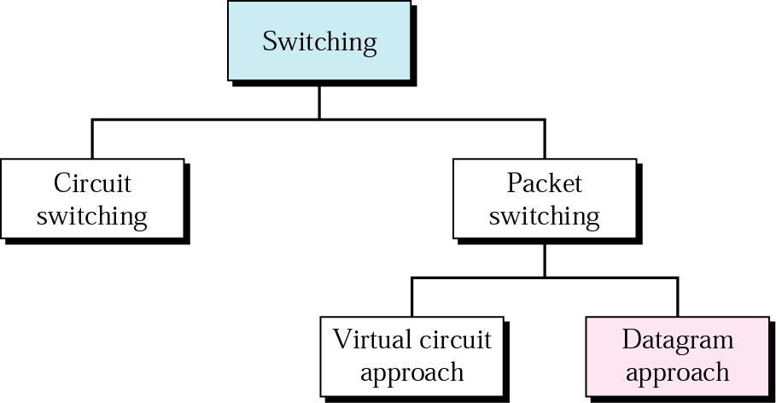
Internet as a Packet-Switched Network
Notes:
Virtual circuit switching is a packet switching methodology whereby a path is established between the source and the final destination through which all the packets will be routed during a call. This path is called a virtual circuit because to the user, the connection appears to be a dedicated physical circuit. However, other communications may also be sharing the parts of the same path.
Before the data transfer begins, the source and destination identify a suitable path for the virtual circuit. All intermediate nodes between the two points put an entry of the routing in their routing table for the call. Additional parameters, such as the maximum packet size, are also exchanged between the source and the destination during call setup. The virtual circuit is cleared after the data transfer is completed.

Slide 13
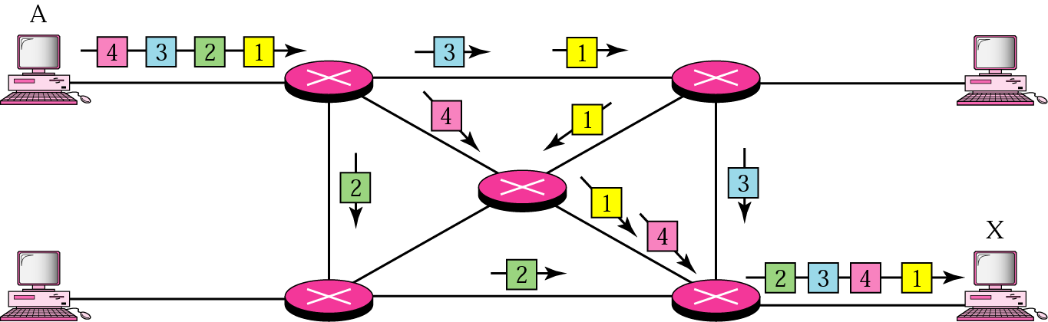
Datagram Packet Switching
The Internet, at the network layer, is a packet-switched network.
Switching can be divided into three broad categories: (i) Circuit Switching, (ii) Packet Switching and (iii) Message Switching.
The Internet has chosen the datagram approach to switching in the network layer.
It uses the universal addresses defined in the network layer to route packets from the source to the destination.

Slide 14
The Internet Protocol
At the Internet layer, the Internet Protocol (IP) is used.
Packets in the Internet layer are called Datagrams.
An IP, a datagram is a variable-length packet (up to 65,536 bytes) consisting of two parts:
header and
data
For IPv4, the maximum datagram size is up to 65,536 bytes = 64 MB.
The IPv4 header can be from 20 to 60 bytes and contains information essential to routing and delivery.
The header identifies the sender of the datagram (source IP address) and the intended recipient of the datagram (destination IP address).

Slide 15
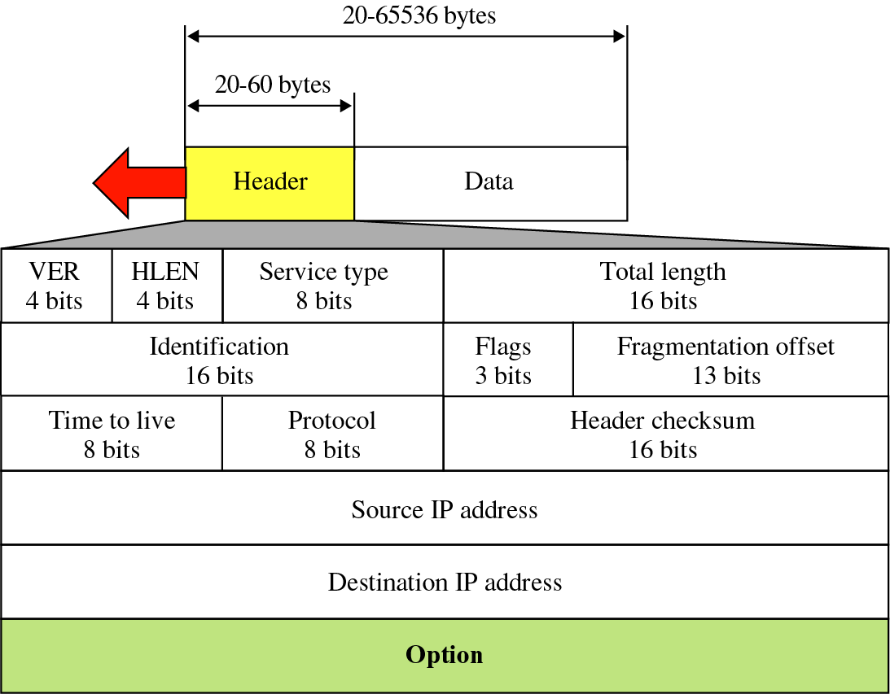
IPv4 Datagram
4
4
4
4
4
A datagram is a variable-length packet consisting of two parts: header and data.
The header is 20 to 60 bytes in length and contains information essential to routing and delivery.
Notes:
The IPv4 header checksum is a simple checksum used in the version 4 of the Internet Protocol (IPv4) to protect the header of IPv4 data packets against data corruption. This checksum is calculated only for the header bytes (with the checksum bytes set to 0), is 16 bits long and is a part of the IP packet header.

Slide 16
Multihomed Devices
Any device connected to more than one network must have more than one IP address.
Such a device has a different address for each network it is connected to.
We can say these devices as the multihomed and the addresses can possibly belong to different classes.
For example, router.

Slide 17
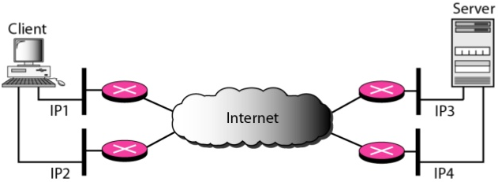
Multihomed Devices
In this figure, the Client and Server are connected to two local networks with two different IP addresses.
The Client and Server can make an association, using four different pairs of IP addresses.
In the current implementations of Stream Control Transmission Protocol (SCTP), only one pair of IP addresses can be chosen for normal communication. The alternative is used if the main choice fails.
Stream Control Transmission Protocol (SCTP) is a new reliable, message-oriented transport layer protocol.
It is mostly designed for Internet applications that have recently been introduced.

Slide 18
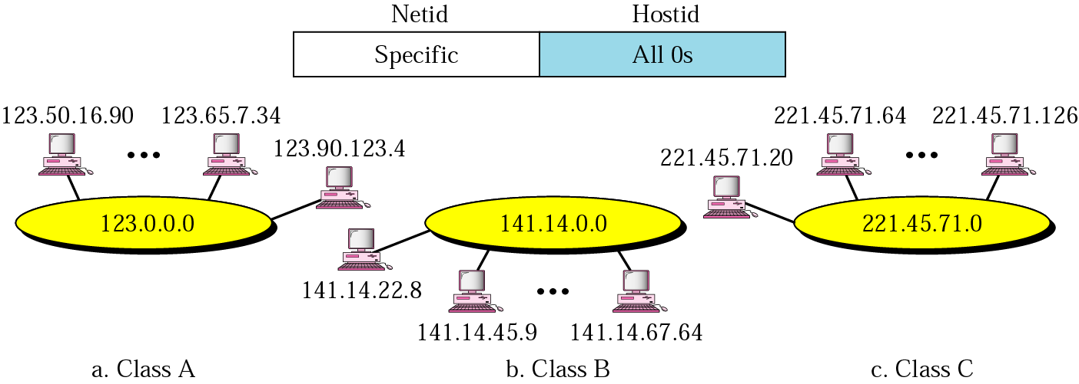
IPv4 Network Address
An IP address with a hostid of all binary 0s is reserved for the network address.
Therefore, as a Class A network example, 113.0.0.0 is the IP address of the network containing the host 113.1.2.3.
A network address enables a router to put a packet onto the appropriate network segment.

Slide 19
IPv4 Network Address
Example 5
Given the address 23.56.7.91, find the network address.
Solution
The class is A. Only the first byte defines the netid. We can find the Network Address by replacing the hostid bytes (56.7.91) with 0s. Therefore, the network address is 23.0.0.0.
A network address is different from a netid.
A network address has both netid and hostid, with 0s for the hostid.

Slide 20
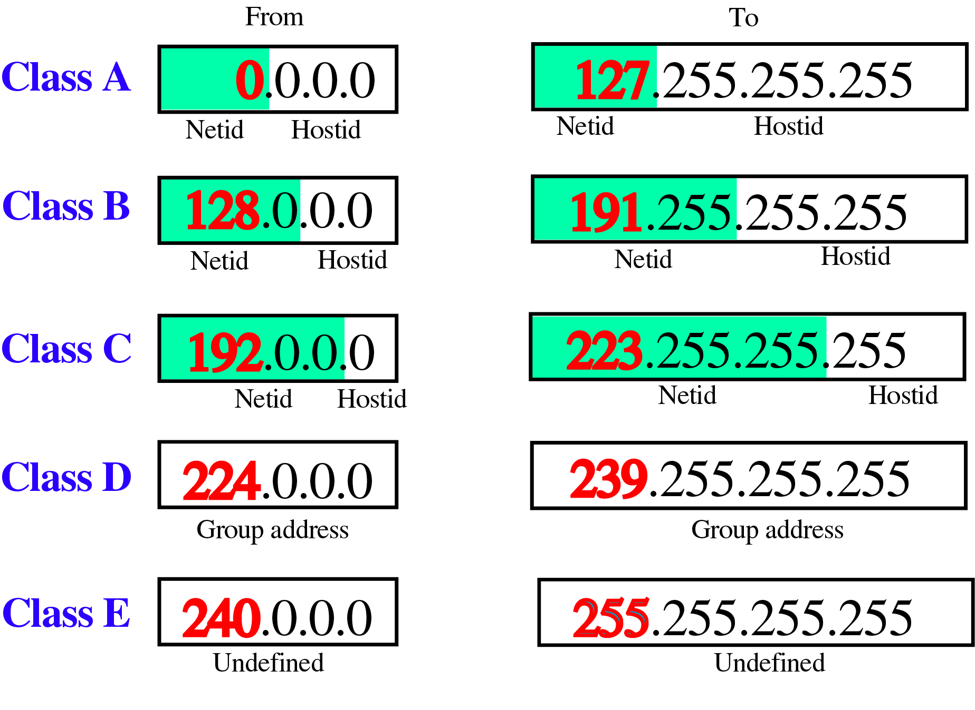
Dotted-Decimal Notation

Slide 21
Network Address Exercise
Find the class of the following IP addresses.
a. 208.34.54.12
Class C (first byte is between 192 and 223)
b. 238.34.2.1
Class D (first byte is between 224 and 239)
c. 114.34.2.8
Class A (first byte is between 0 and 127)
d. 129.14.6.8
Class B (first byte is between 128 and 191)

Slide 22
Network Address Exercise
Question: Find the network address for each
host address:
a. 4.23.145.90
b. 127.34.78.7
c. 146.7.3.8
d. 29.6.8.4
198.76.9.23
hint: first determine the class of address
Notes:
4.23.145.90
Class A, Netid = 4, Hostid = 23.145.90
Network Address: 4.0.0.0
127.34.78.7
Claas A, Netid = 127, Hostid = 34.78.7
Network Address: 127.0.0.0
146.7.3.8
Class B, Netid = 146.7, Hostid = 3.8
Network Address: 146.7.0.0
29.6.8.4
Class A, Netid = 29, Hostid = 6.8.4
Network Address: 29.0.0.0
198.76.9.23
Class C, Netid = 198.76.9, Hostid = 23
Network Address: 198.76.9.0

Slide 23
IPv4 Broadcast Addresses
Broadcast addresses are also reserved.
In class A, B and C, a direct broadcast address is an address that has all 1s in the host field (hostid).
When you send a direct broadcast packet on a network, all devices on the network pick it up.
For example, on a network with a network address of 176.10.0.0, the direct broadcast address would be 176.10.255.255.
Where did we get 255 from?
Notes:
http://learn-networking.com/network-design/how-a-broadcast-address-works

Slide 24
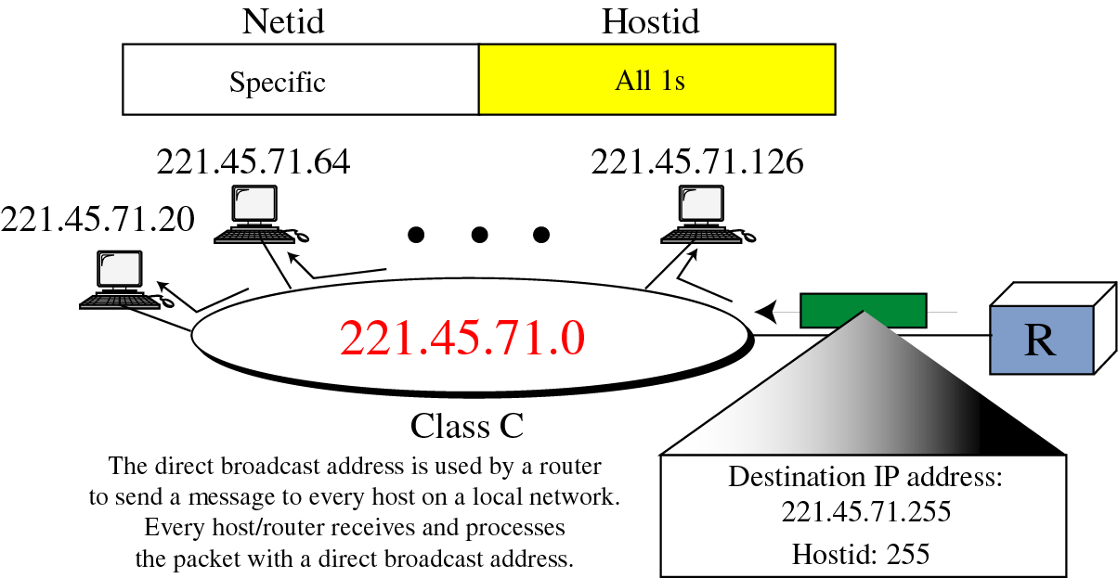
IPv4 Direct Broadcast Address

Slide 25
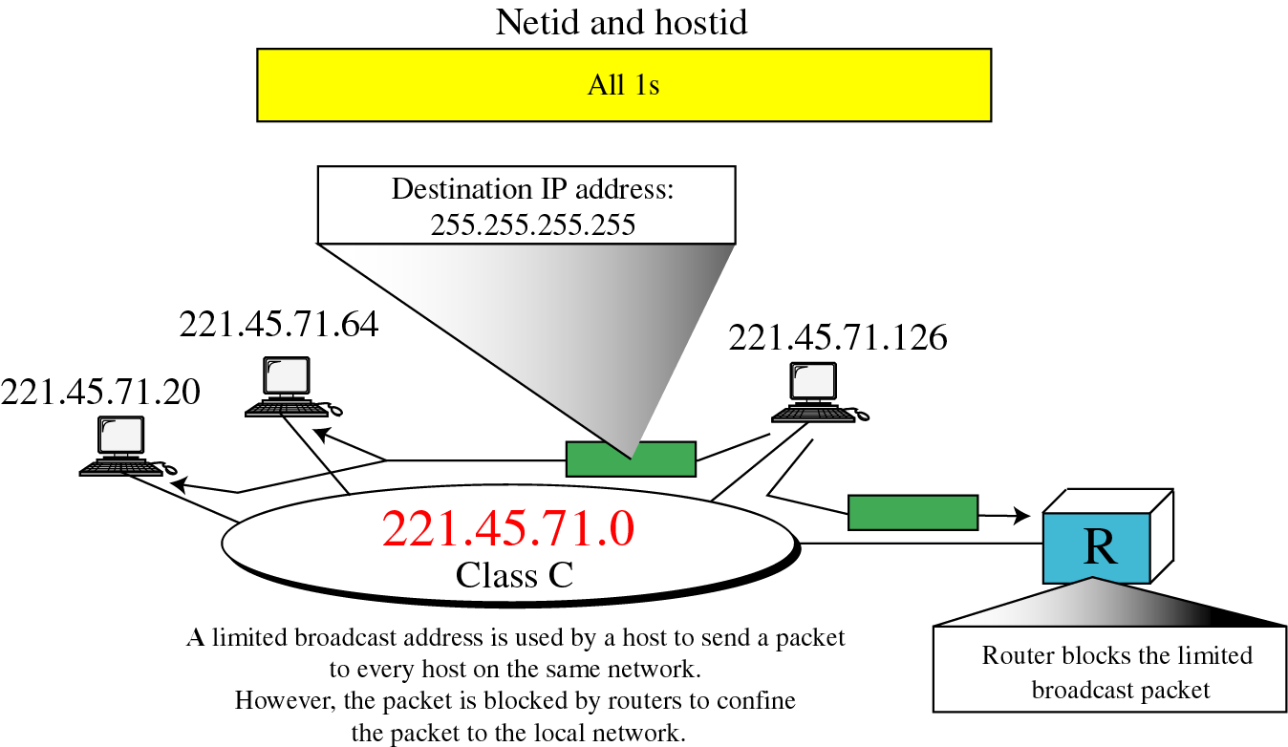
IPv4 Limited Broadcast Address

Slide 26
Special Addresses Exercise
Question:
A host has an IP address of 183.121.56.4
Find the class and address for the network this host resides on.
Find all the special addresses for this network.

Slide 27
Special Addresses Exercise
Answer:
Host Address: 183.121.56.4
First number is between 128 and 191 => Class B
Therefore netid = 183.121 and hostid = 56.4
Network Address = 183.121.0.0
Direct Broadcast Address = 183.121.255.255
Limited Broadcast Address = 255.255.255.255
Default Network or subnet mask for Class B = 255.255.0.0

Slide 28
Numbers of IPv4 Networks and Hosts
Class | Leading bits | Size of network number bit field | Size of rest bit field | Number of networks | Addresses per network | Total addresses in class | Start address | End address
Class A | 0 | 8 | 24 | 128 (2⁸⁻¹) | 16,777,216 (2²⁴) | 2,147,483,648 (2³¹) | 0.0.0.0 | 127.255.255.255
Class B | 10 | 16 | 16 | 16,384 (2¹⁶⁻²) | 65,536 (2¹⁶) | 1,073,741,824 (2³⁰) | 128.0.0.0 | 191.255.255.255
Class C | 110 | 24 | 8 | 2,097,152 (2²⁴⁻³) | 256 (2⁸) | 536,870,912 (2²⁹) | 192.0.0.0 | 223.255.255.255
Class D (multicast) | 1110 | not defined | not defined | not defined | not defined | 268,435,456 (2²⁸) | 224.0.0.0 | 239.255.255.255
Class E (reserved) | 1111 | not defined | not defined | not defined | not defined | 268,435,456 (2²⁸) | 240.0.0.0 | 255.255.255.255
Source: https://en.wikipedia.org/wiki/Classful_network

Slide 29
Numbers of IPv4 Networks and Hosts
Class | Number of Networks | Number of Hosts
A | 2⁷ – 2 = 126 | 2²⁴ – 2 = 16,777,214
B | 2¹⁴ = 16,384 | 2¹⁶ – 2 = 65,534
C | 2²¹ = 2,097,152 | 2⁸ - 2 = 254
D | Not applicable | Not applicable
E | Not applicable | Not applicable
Note: We subtract 2 from Class A networks since 127.x.x.x is unusable (reserved for loopback) and also 0.x.x.x is reserved.

